Slide 1
2. Internet protocol (Part 1: Why IP?)
Rocky K. C. Chang
Chung Yuan Christian University
Dept. Information and computer engineering
March 1, 2023

Slide 2
Source: https://www.bahnmops.de/images/tuebingen/protocolchart.pdf

Slide 3

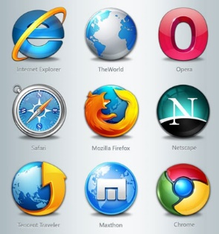
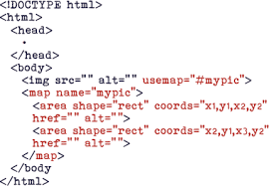

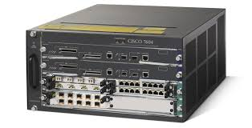
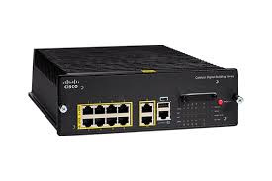
https://www.google.com.hk/
HTTP
https://www.google.com.hk/
TLS/SSL
TCP port
TCP port
TCP
IP address
IP address
158.132.1.1
IP
IP
IP
IP
172.217.163.227
MAC address
MAC address
802.11
Ethernet

Slide 4
0. Protocol suite convergence
Quite a few convergence phenomena occurred in the computer networking field (and many others)
  Wired LAN: Token ring/bus, FDDI, … → Ethernet
  ATM, IP → IP
  TCP/IP, XNS, SNA, … → TCP/IP
Why almost all protocol suites vanish except TCP/IP?

Slide 5
0.1 Design Goals
A very common design goal is to dominate the market by a proprietary product.
  IBM, Xerox, DEC, Novell, …
Another uncommon design goal is to accommodate all existing (and perhaps the future) product.
  Internet
Why different design goals?

Slide 6
1. The internetworking problem
Problem: How to interconnect heterogeneous networks effectively?
One solution is based on the datalink layer.
  Use bridges (L2 switches) to connect two different datalink networks.
  These bridges know both datalink protocols.

Slide 7

1.1 A L2 solution
Network 1 (Ethernet)
H7
S3
H8
H1
H2
H3
Network 4
Network 2 (Ethernet)
(point-to-point)
S1
S2
H4
Network 3 (FDDI)
H5
H6

Slide 8
1.1 A l2 solution
Interconnect heterogeneous networks directly, e.g.,
  DIX Ethernet with IEEE Ethernet
  Ethernet with Token Ring
  Wired LAN with wireless LAN
Three problems with interconnection at the data-link layer:
  Do not scale to the number of data-link technologies.
  Do not scale to the number of hosts (or networks).
  Do not have a common addressing space.

Slide 9
1.1.1 Scaling to data-link technologies
Conversion between frame structures.
Scalability problem as the number of data-link technologies supported increases, e.g.,
Ethernet
Token ring
PPP
FDDI
Frame conversion

Slide 10
1.1.2 Scaling to network size
A switched LAN is a “flat” network---A single broadcast frame reaches every LAN.
  Virtual LAN (VLAN) can relieve this problem at the expense of managing VLAN membership.
Spanning tree protocol does not scale well to network size.
  Take a longer time for the protocol to converge.
  Take a longer time to respond to network state changes.

Slide 11
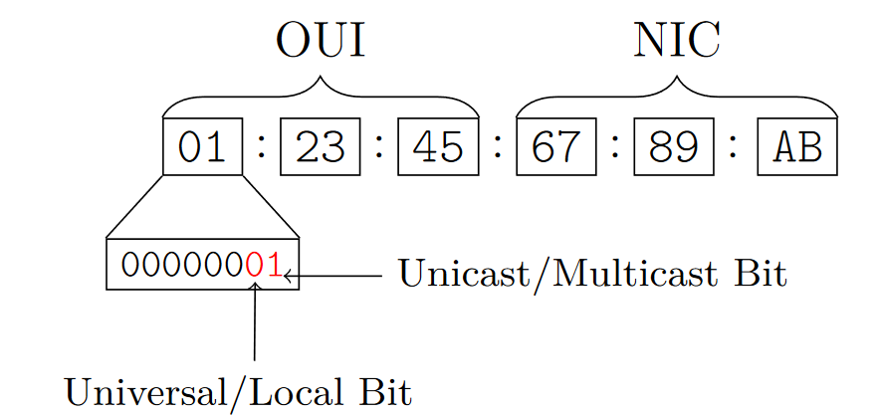
1.1.3 Uncommon MAC address space
Different structures and number of bits used in MAC address space
  EUI-48 (a 24-bit OUI and a 24-bit NIC)
  EUI-64 (a 24 (or 36) bit OUI and a 40 (or 28) bit NIC
  Network Service Access Point address (NSAP address): E.164
Each address in a data-link technology must be universally unique.

Slide 12
2. A L3 solution
Overlay IP on top of different datalink networks.
Replace bridges with L3 switches, more commonly known as routers.
Add TCP/IP software to each end host (with the whole protocol suite software).
Assign an IP address to each network interface.

Slide 13














2.1 A l3 internetworking solution
Network 1 (Ethernet)
H7
S3
H8
H1
H2
H3
Network 4
Network 2 (Ethernet)
(point-to-point)
S1
S2
H4
Network 3 (FDDI)
H5
H6

Slide 14
2.1 A l3 internetworking solution
Network 1 (Ethernet)
H7
S3
H8
H1
H2
H3
Network 4
Network 2 (Ethernet)
(point-to-point)
S1
S2
H4
Network 3 (FDDI)
H5
H6

Slide 15
2.1.1 Scaling to data-link technologies
Ethernet
Token ring
IP
PPP
FDDI
Encapsulation and demultiplexing

Slide 16
2.1.2 Scaling to network size
IP network uses hierarchies to achieve scalability.
There are at least three levels:
  A single IP host (e.g., 140.135.201.3)
  IP subnets (X subnets in 140.132.0.0/16)
  An autonomous system (TANET, ASN: 1659, https://ipinfo.io/AS1659)

Slide 17
2.1.3 Uncommon MAC address space
Create a logical (unicast) address space to identify network interfaces.
Classes A-C for unicast and class D for multicast:
(a)
0
Network
Host
14
16
(b)
1
0
Network
Host
21
8
(c)
1
1
0
Network
Host
28
(d)
1
1
1
0

Slide 18
3. Encapsulation and address binding
To transmit IP datagrams over any data-link network, two requirements are needed:
  A standard way to encapsulate IP datagrams
  Address resolution between IP addresses and MAC addresses
Standard RFCs for specifying datagram encapsulations and possibly address resolutions, e.g., Ethernet (RFC 894), IEEE 802 (RFC 1042), etc.
A shared medium uses an Address Resolution Protocol (ARP) for address binding.

Slide 19
3.1 Data encapsulation
Standards for IP over anything
  IP over DIX Ethernet
  IP over IEEE 802.3
  IP over PPP
  IP over ATM
  IP over …
Go the RFC Index and see how many RFC entitled “ … IP datagrams over …”

Slide 20
3.1.1 Encapsulation across the stack
user input
HTTP
Appl. data
TCP
TCP hdr
Appl. data
IP
IP hdr
TCP hdr
Appl. data
ETH
Eth. hdr
IP hdr
TCP hdr
Appl. data
Send out to the network interface

Slide 21
3.1.2 demultiplexing across the stack
Other TCP-based application processes
Appl. data
UDP-based applications
TCP hdr
Appl. data
Other nonIP network protocols
IP hdr
TCP hdr
Appl. data
Eth. hdr
IP hdr
TCP hdr
Appl. data
Received from the network interface

Slide 22
3.2 Address resolution protocol (ARP)
An ARP request message is data-link broadcasted on the LAN with the target IP address.
Every IP host picks up a copy of the message and examine the target IP address.
  If matching its IP address, send an ARP reply message back to the sender with its MAC address.
  Else, drop the message.
To reduce broadcast traffic, each host uses an ARP cache to remember the recent binding.

Slide 23
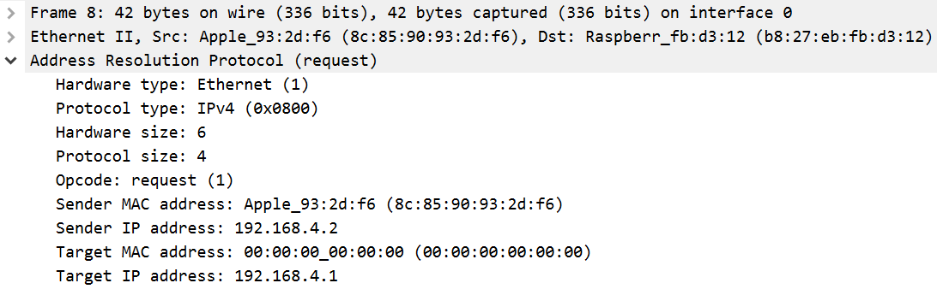
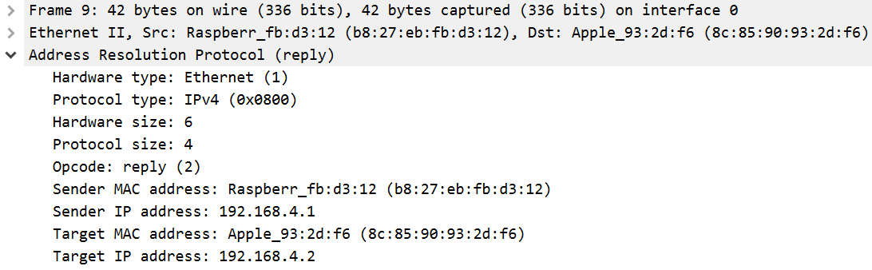
3.2.1 ARP messages

Slide 24
ARP exercises I
Start packet capturing using Wireshark and filter ARP messages.
How many ARP request messages and reply messages do you capture?
Find the matching ARP request and reply messages.
Why can’t you see some of the reply messages?

Slide 25
ARP Exercises II
Use arp –a to examine the content of the arp cache.
  What kinds of entries are there?
Use arp –d * for Win (as administrator) and sudo arp –d –a for MacOS to clear the cache and then display the content.
  Is the cache completely empty?
Issue tracert or ping to a remote host, such as 8.8.8.8. Any change in the ARP cache?
Did your tracert or ping induce any ARP request?

Slide 26
ARP Exercises III
Repeat the last experiment with ping (sending ICMP messages).
Filter ICMP packets. What are the source and destination MAC addresses in the ping request message?
Use the result in the last question to explain the result in the last exercise.

Slide 27
3.3 A more general example
On each “hop or link,” both data encapsulation and address resolution occur.
H1
H8
TCP
R1
R2
R3
TCP
IP
IP
IP
IP
IP
ETH
ETH
FDDI
FDDI
PPP
PPP
ETH
ETH

Slide 28
Summary
IP is a solution to the internetworking problem.
It resolves three problems:
  Scaling to data-link technologies
  Scaling to network size
  Uncommon MAC addresses
There are only two requirements for IP to run on top of any “data-link network.”

